Slide 1

16-Source Interrupt Controller
Priority Resolution, Selective Masking & Multi-Cycle Handshake Architecture
Team: T028 | 4 Students | Focus: Hardware Synchronization & Race Mitigation
M Abhiram Manikanta Reddy – 2400040026
B Lokesh – 2400040120
N Shashi Kiran Reddy – 2400040132
A Charan Teja Reddy – 2400040133

Slide 2
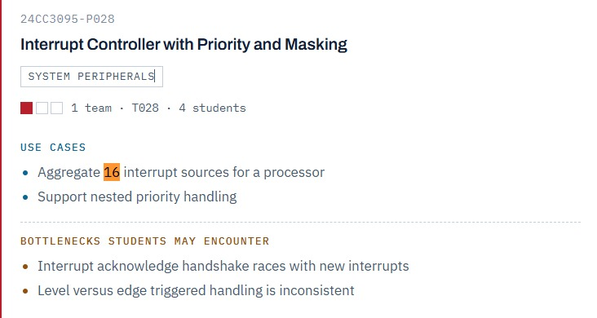
Problem Statement

Slide 3



System Requirements & Use Cases
16-Channel Line Aggregation
Preemptive Priority Handling
Combines 16 distinct peripheral hardware interrupt lines (IRQ0 to IRQ15) into a single processor interrupt request signal.
Supports nested interrupt priority rules, allowing critical high-priority events to interrupt running lower-priority handlers.
Translates pending hardware requests into a 4-bit vector ID during the CPU acknowledge pulse to streamline processing.
Provides software-configurable Interrupt Mask Registers (IMR) to selectively enable or suppress individual IRQ lines.

Slide 4

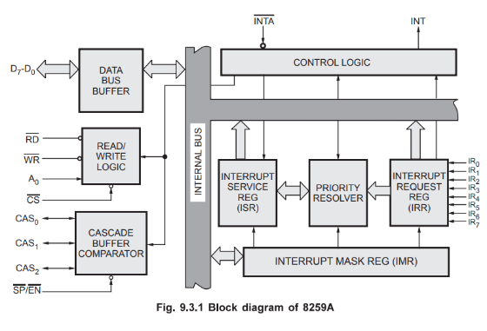
16-Channel Architecture & Registers
16-bit Interrupt Request Register (IRR): Latches asynchronous peripheral inputs (IRQ0–IRQ15).
16-bit Interrupt Mask Register (IMR): Bitwise mask to disable or clear specific interrupt channels.
16-bit In-Service Register (ISR): Tracks currently executing interrupt levels for nested preemption.
Priority Resolver (PR): Combinational logic evaluating highest pending unmasked bit in real time.

Slide 5
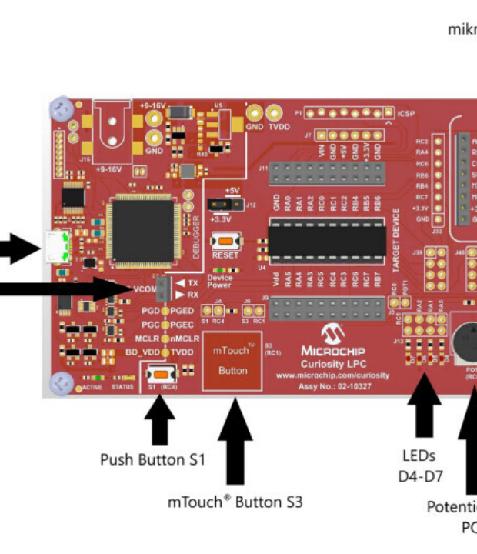
Nested Priority Handling
Fixed Priority Mode
IRQ15 holds the highest priority; IRQ0 holds the lowest priority. The priority resolver selects the highest-priority pending and unmasked interrupt.
Nested Interrupt Handling
A higher-priority interrupt can preempt a currently active lower-priority interrupt. After the higher-priority interrupt is serviced, the processor can return to the lower-priority interrupt.

Slide 6

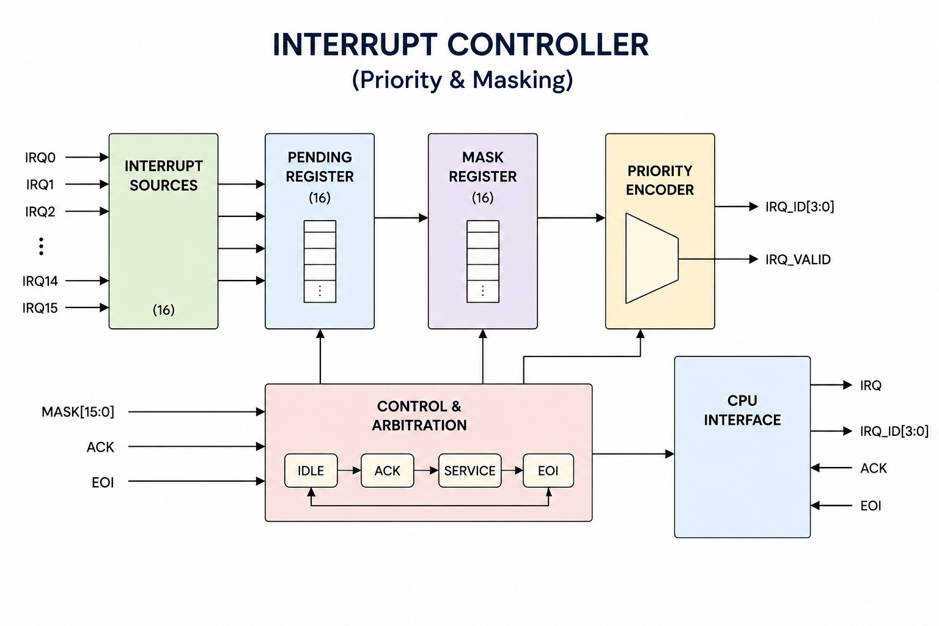
Block Diagram

Slide 7








Primary Hardware Bottlenecks
INTA Handshake Races
Level vs. Edge Triggering
Pending Interrupt Management
Race conditions occur when a new, higher-priority IRQ arrives in the middle of a multi-cycle CPU interrupt acknowledge handshake.
Inconsistent pulse widths cause double interrupts (edge) or missing clears leading to endless IRQ re-triggering (level).
New interrupts arriving while another interrupt is being acknowledged must be captured correctly and must not be lost. The pending register preserves unserviced interrupt requests for the next arbitration cycle.

Slide 8

Level vs. Edge Trigger Analysis
Feature | Level-Triggered Mode | Edge-Triggered Mode
Detection Criterion | Active HIGH voltage level sustained on IRQ line | LOW-to-HIGH rising edge transition on IRQ line
Latching Mechanism | Remains pending while interrupt source is active | Latched when a rising edge is detected
Clearing Action | Source should deassert to prevent re-triggering | Pending interrupt is cleared when the interrupt is acknowledged.
Design Risk / Bottleneck | Stuck-at-HIGH pins cause repeated interrupt servicing | Glitch sensitivity; lost pulses if pulse width < t_CLK

Slide 9




INTA Handshake & Race Control
2. Priority Lock
4. INTA Cycle 2
Priority resolver freezes winner to prevent mid-cycle races.
Vector sent to data bus; winner bit moved to ISR register.
1. IRQ Arrival
3. INTA Cycle 1
Peripheral asserts IRQ; unmasked line latches into IRR.
CPU acknowledges; latched vector ID locked into output buffer.

Slide 10

16-Line Vector Aggregation
Resolving Handshake Races
16:1
By implementing a 2-stage synchronizer and an atomic Priority Freeze Latch on INTA assert, Team T028 resolves race conditions cleanly.
New incoming IRQs during an active INTA cycle are queued safely in the IRR for the next arbitration cycle without corrupting the active vector bus.
Peripheral IRQ Aggregation Ratio

Slide 11
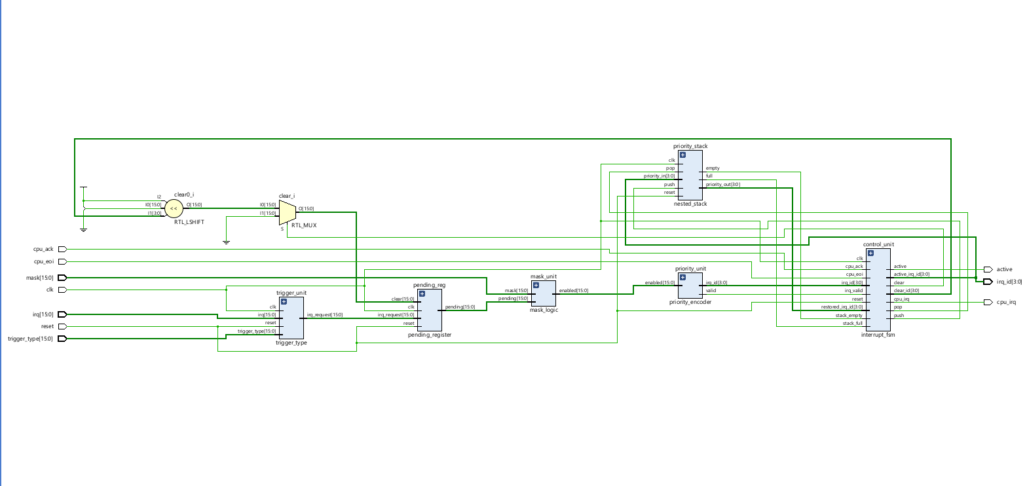
Vivado schematic

Slide 12
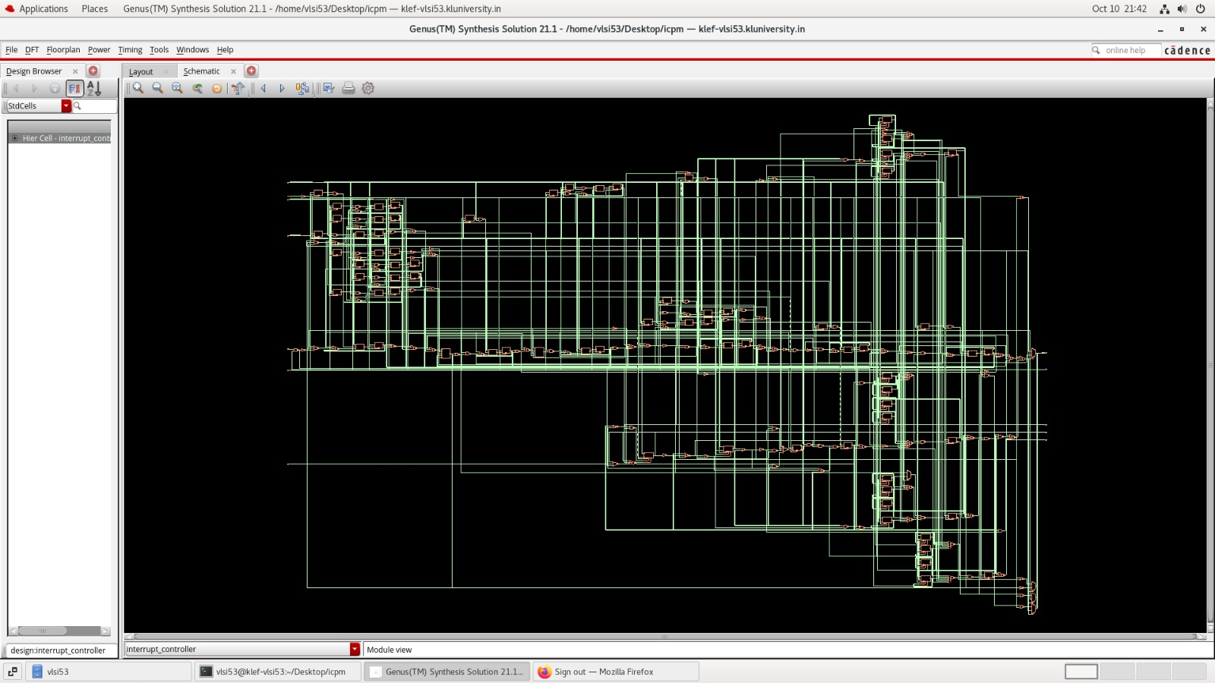
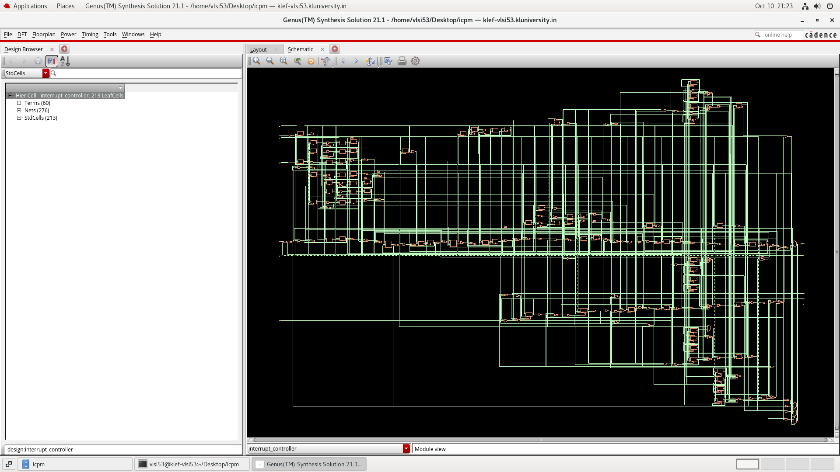
Cadence Synthesis

Slide 13
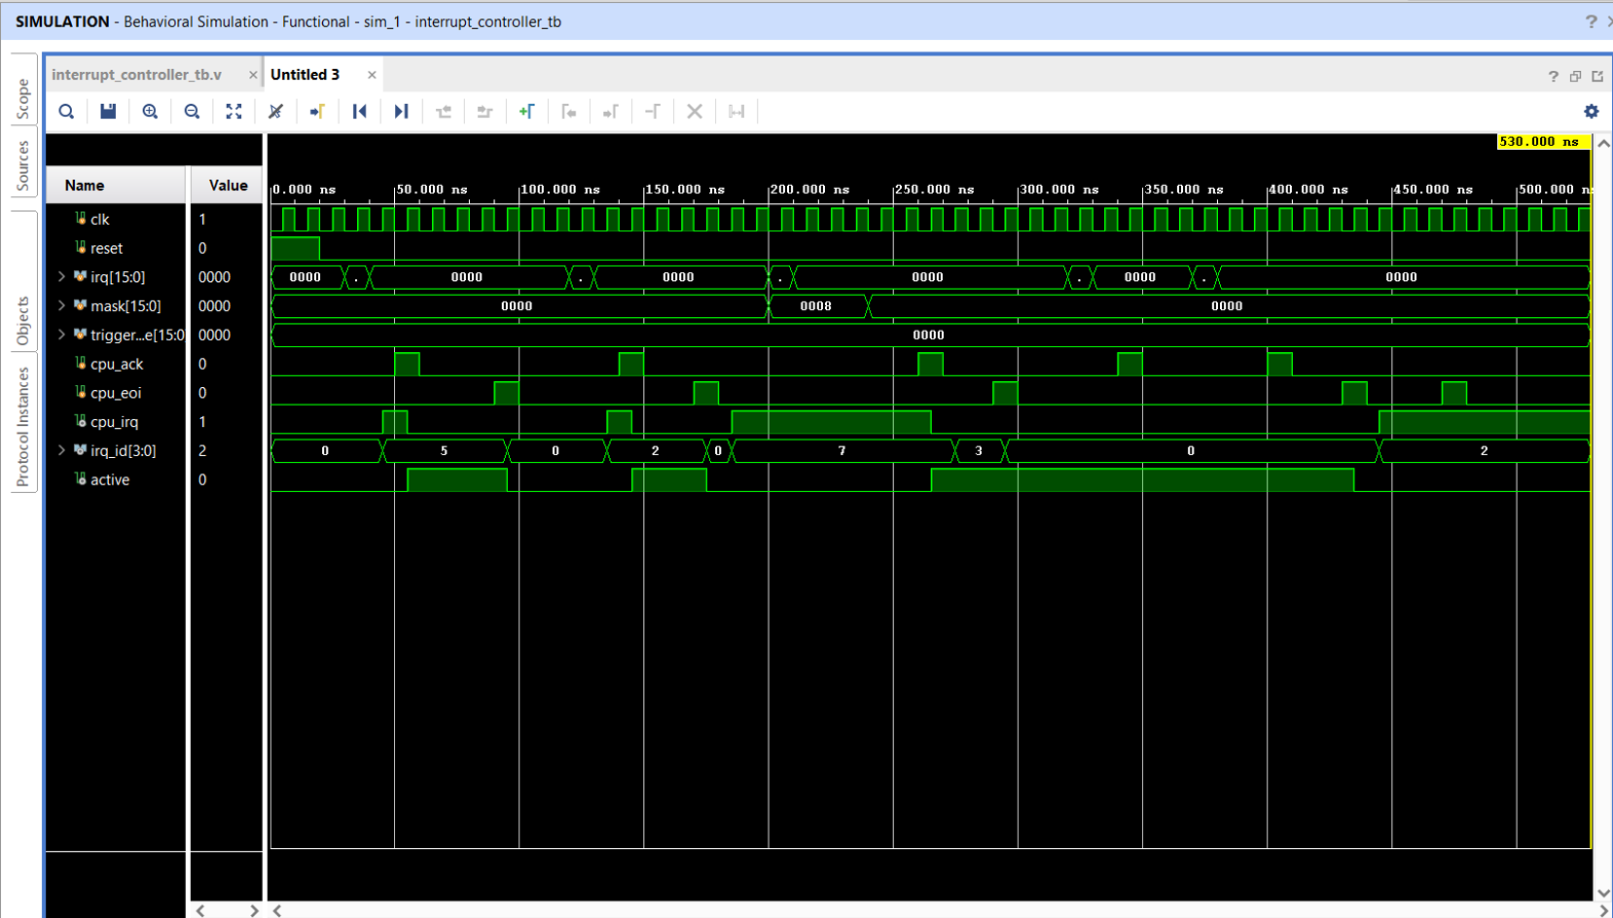
Result Vivado:

Slide 14
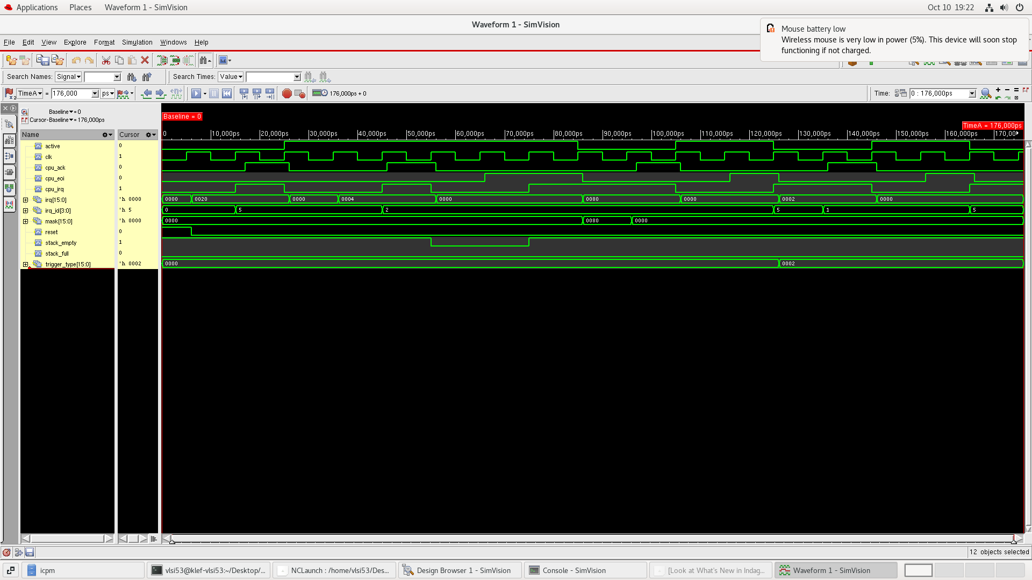
Cadence Result

Slide 15
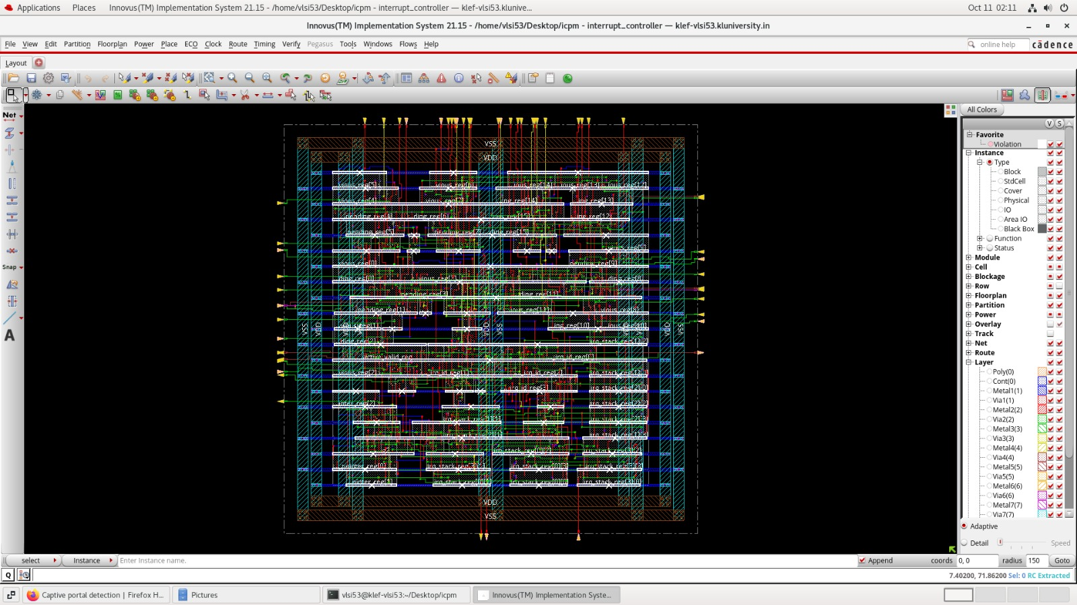

Design Rule Check

Slide 16
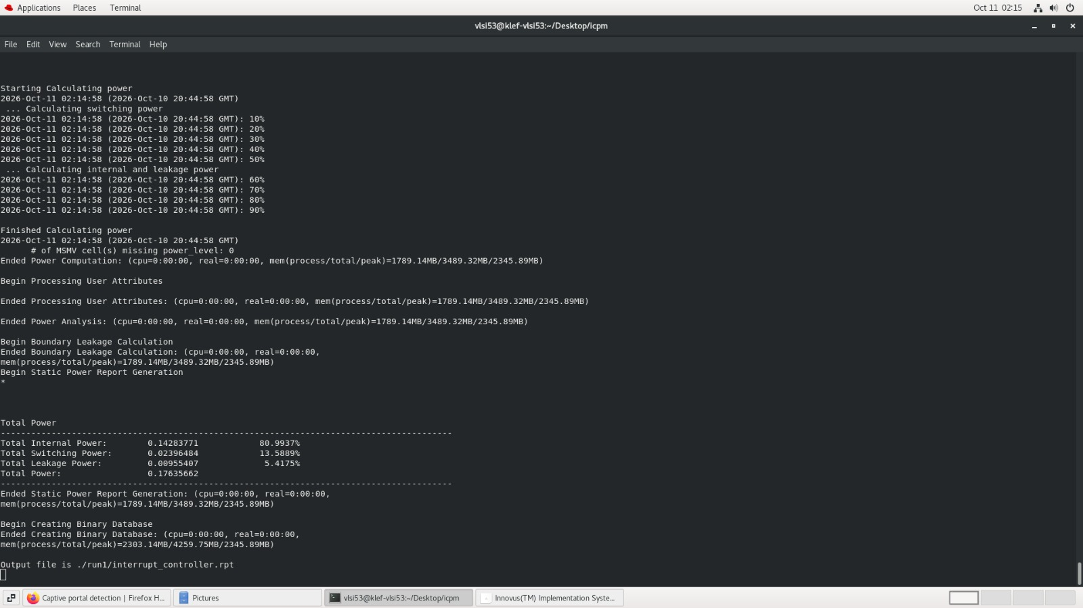
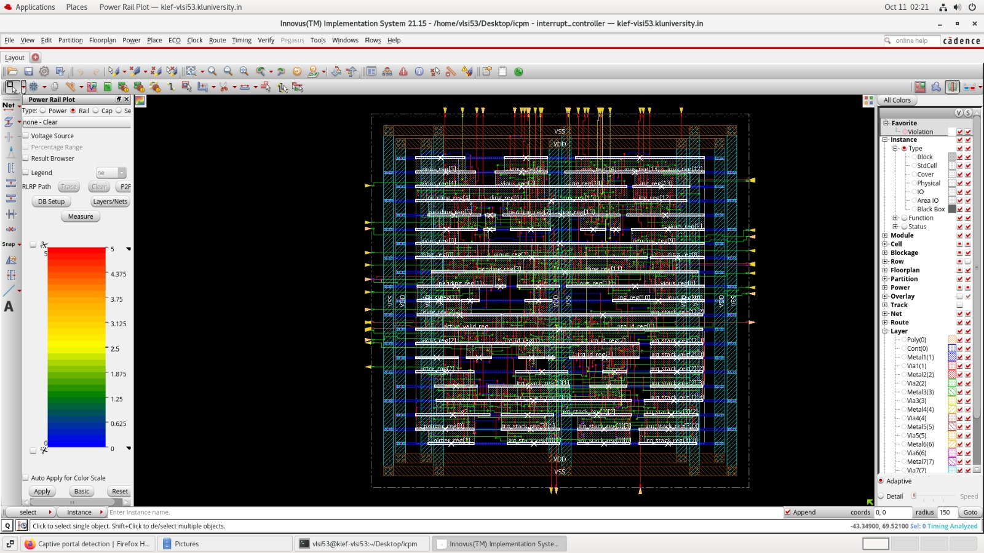
Power Analysis

Slide 17

Filter

Slide 18
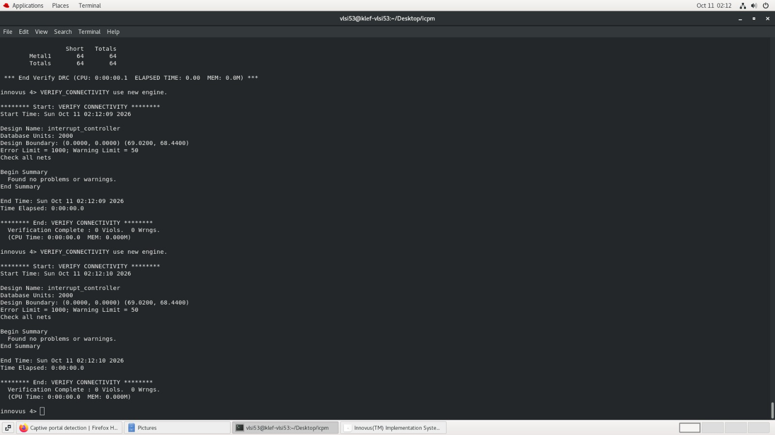
Verify Connectivity

Slide 19
GDSII

Slide 20
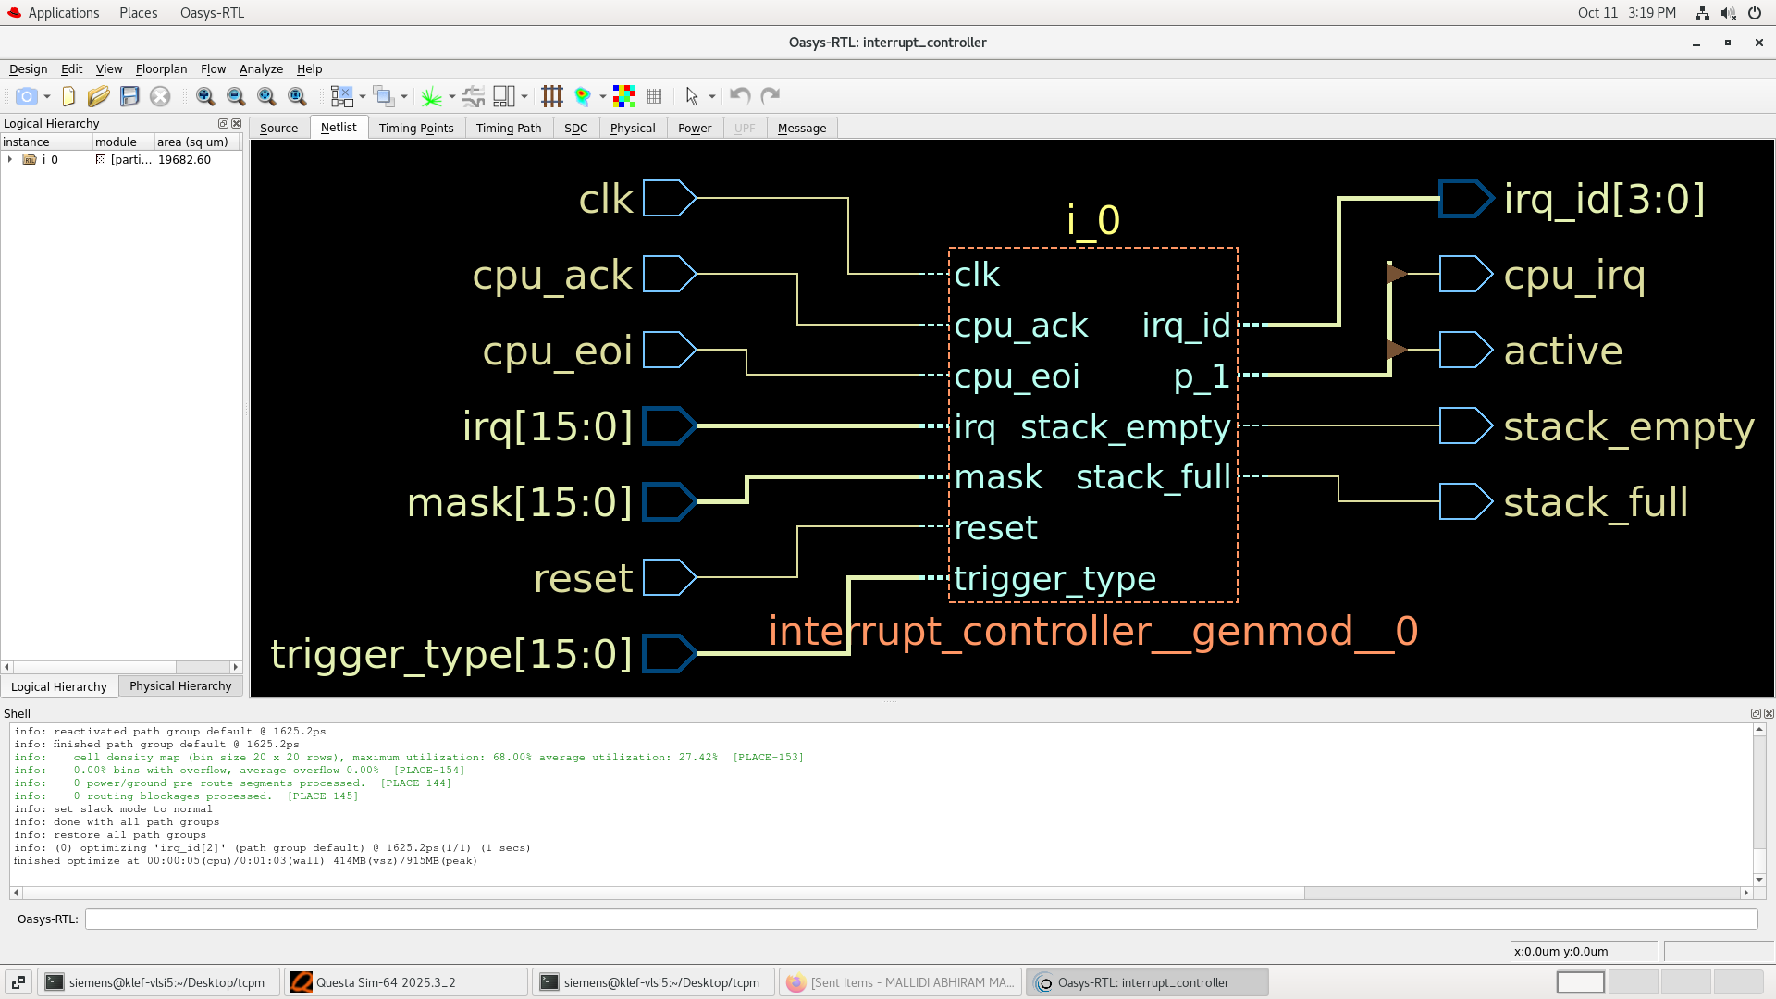
Verification

Slide 21
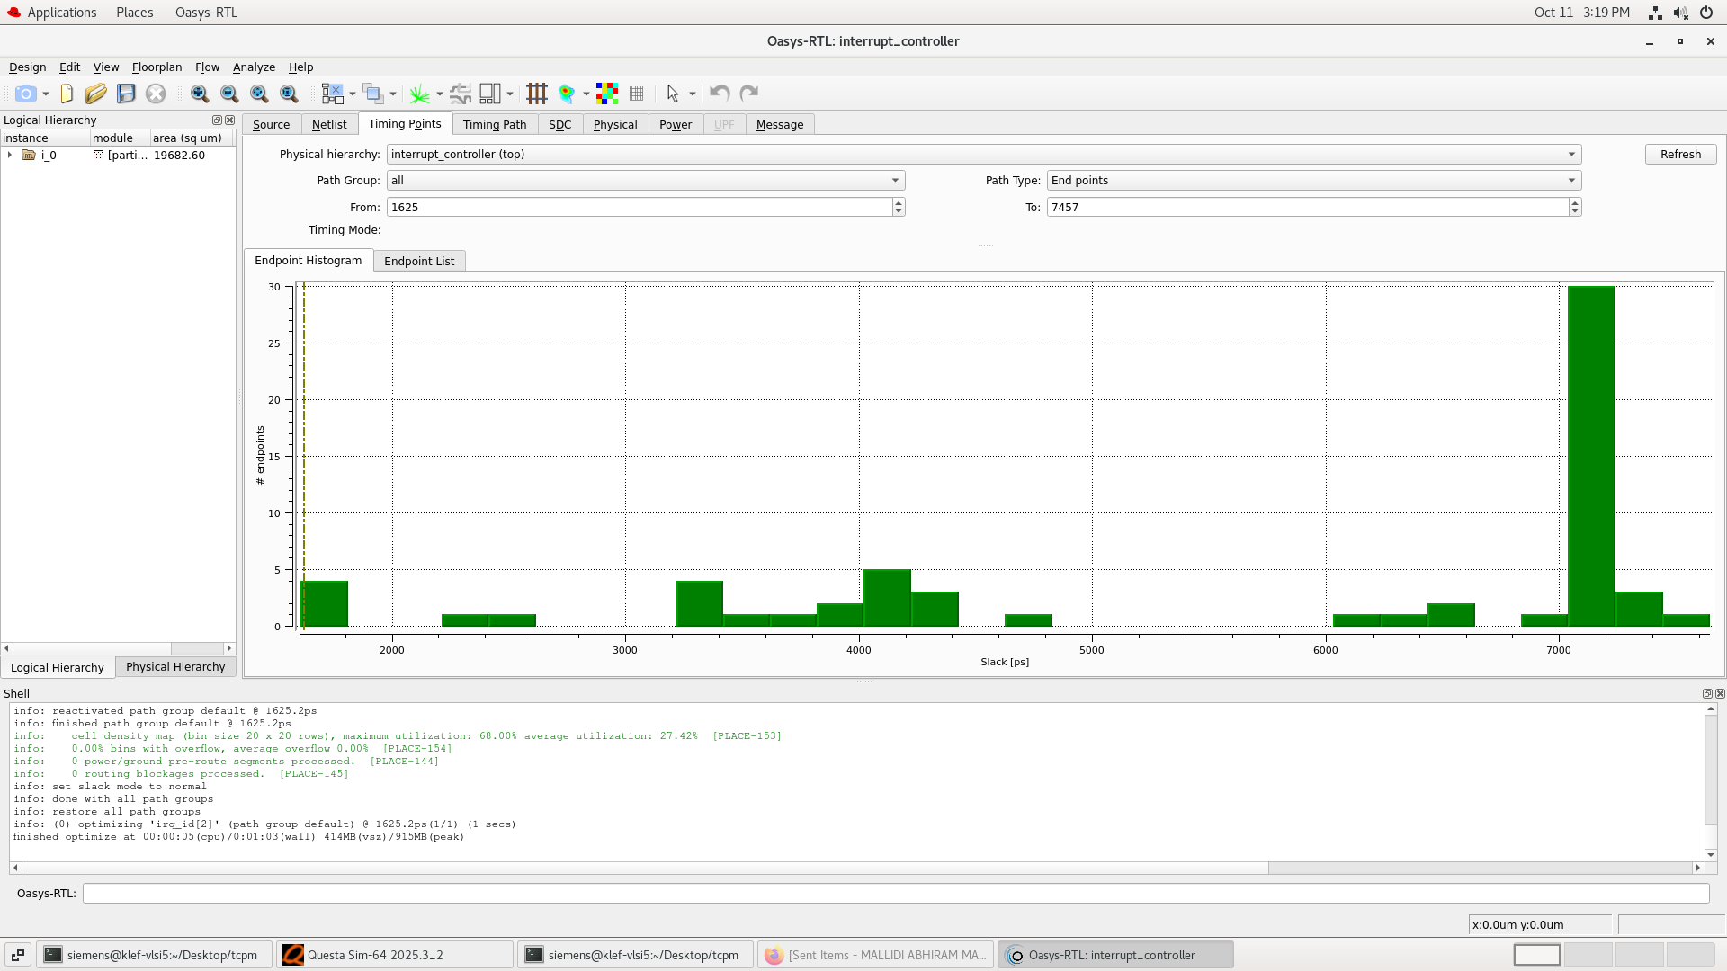

Slide 22
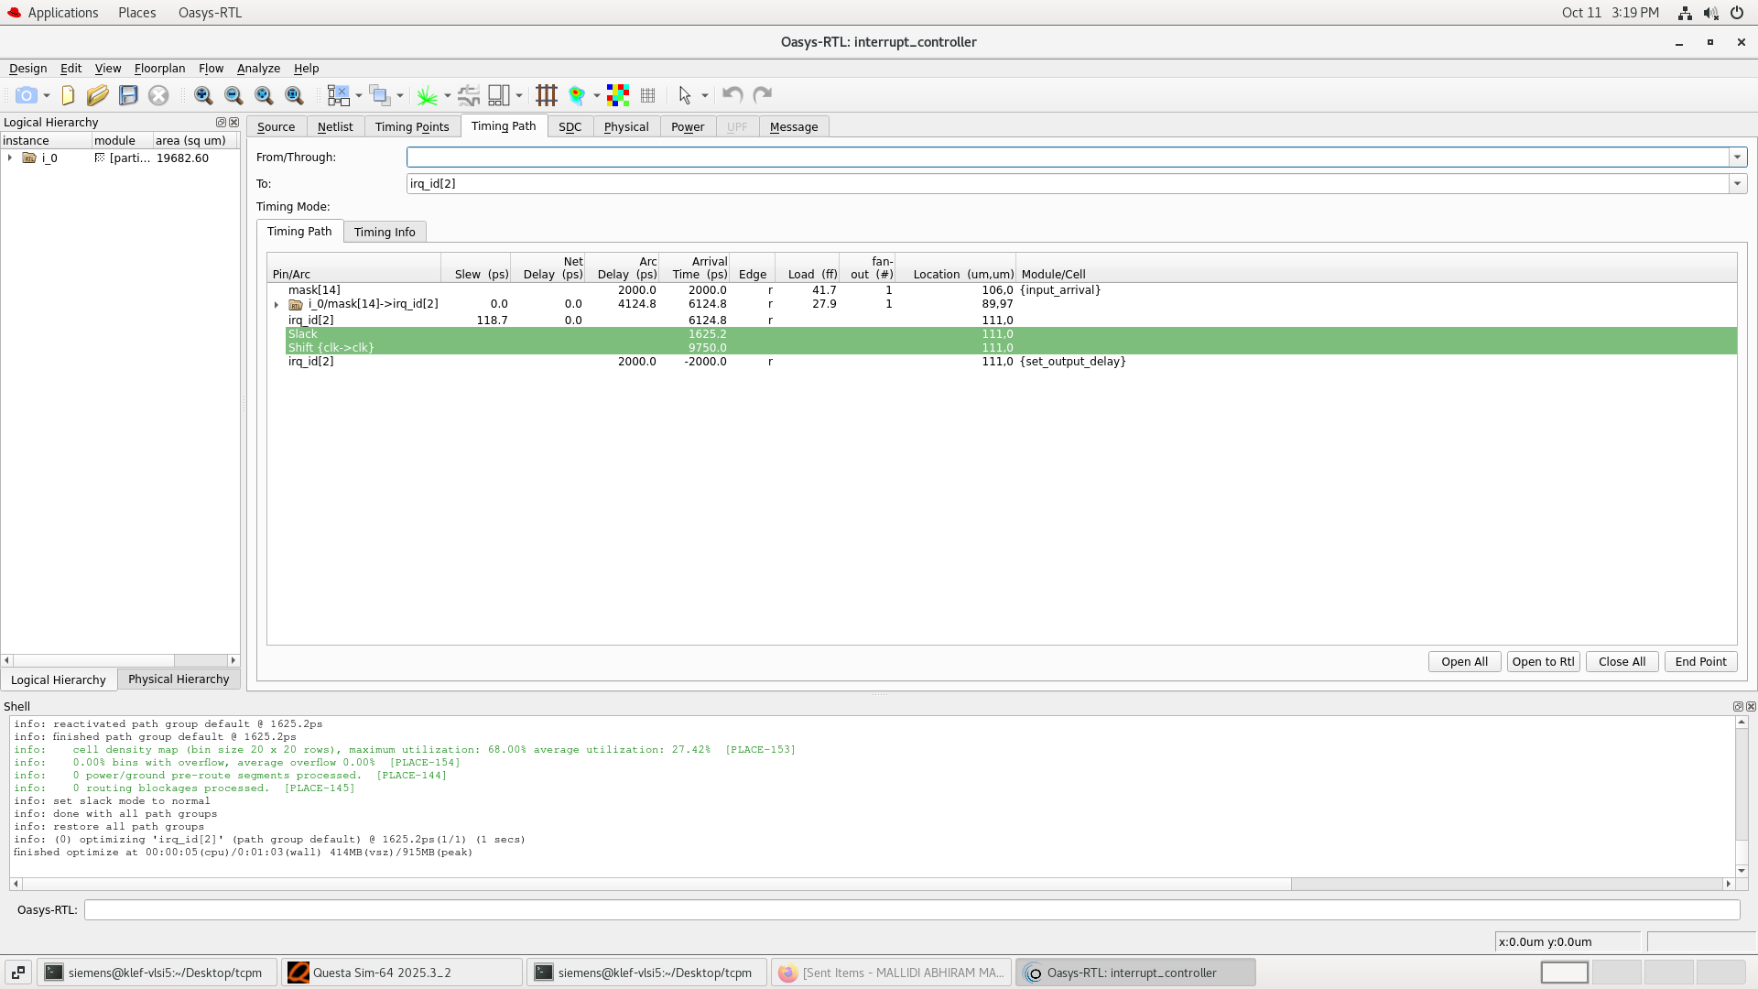

Slide 23
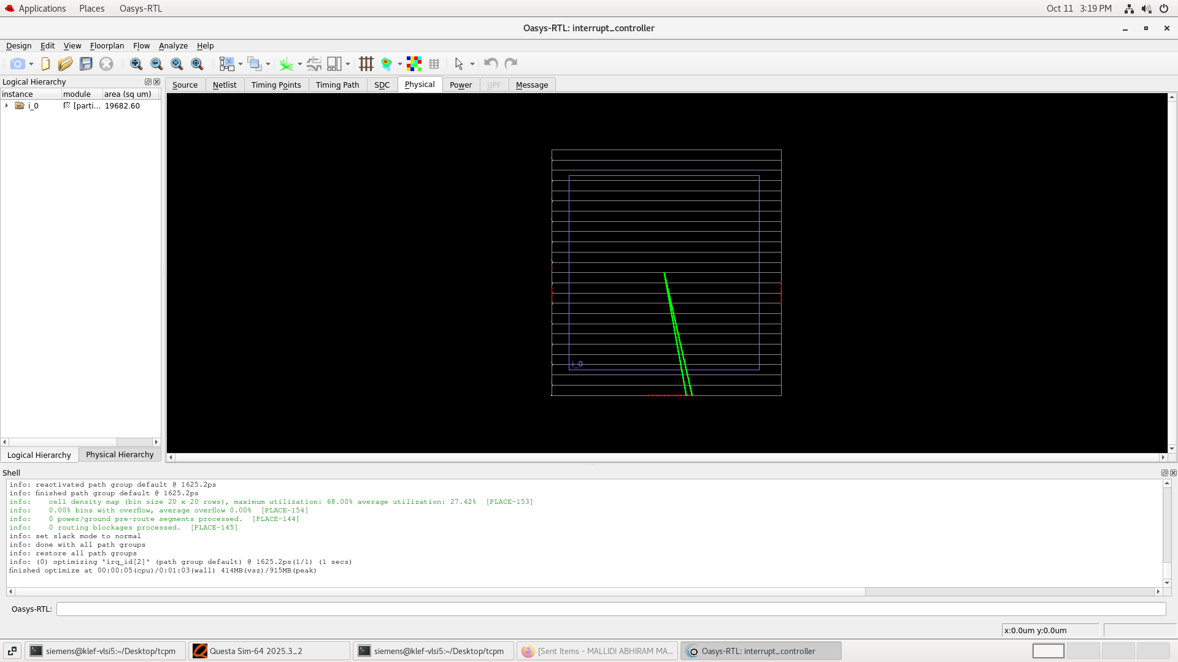

Slide 24
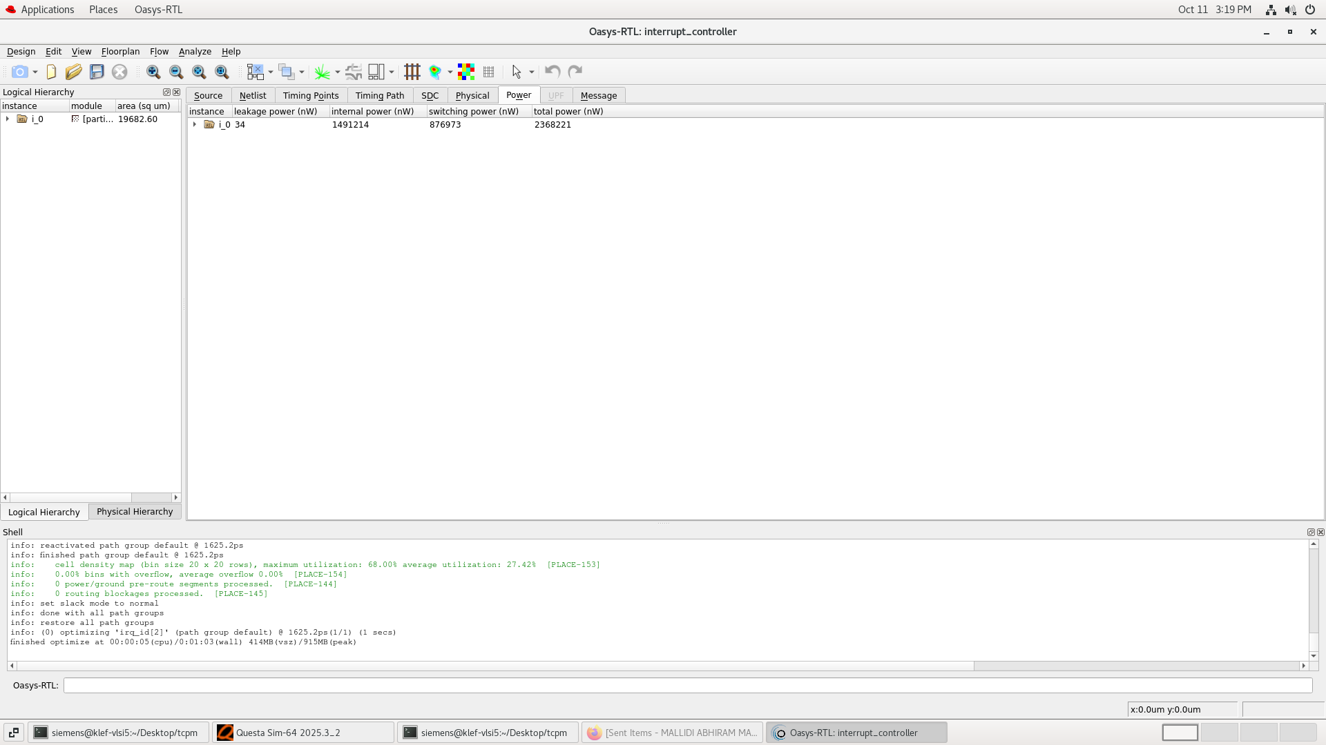

Slide 25
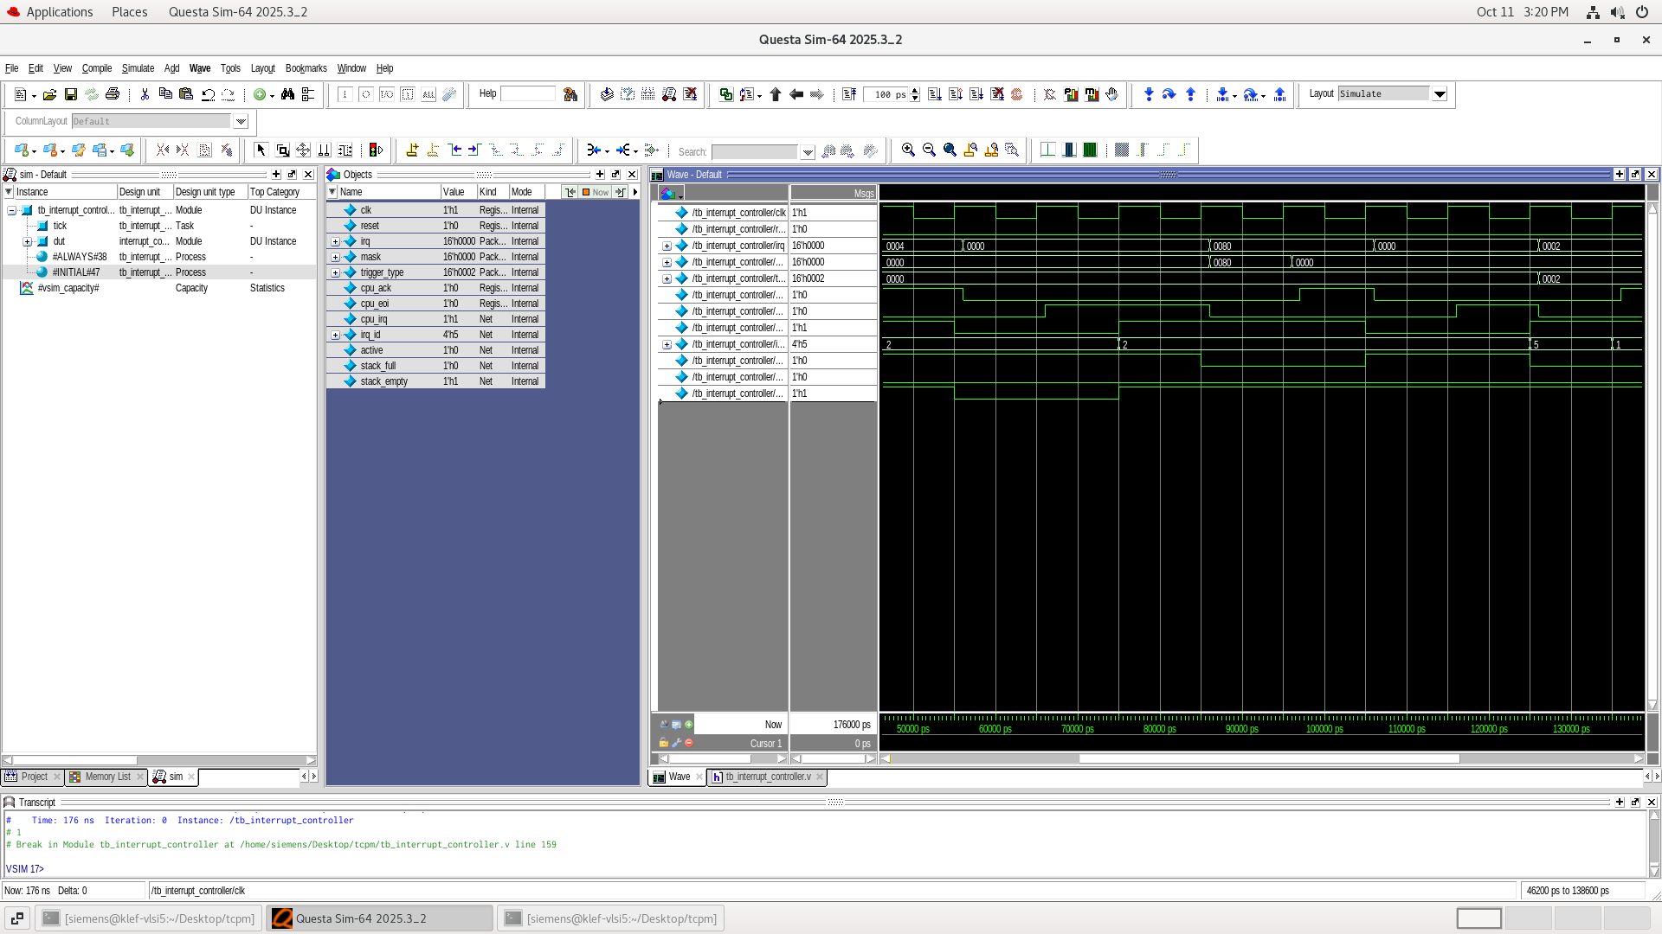

Slide 26
Thank you

